Slide 1
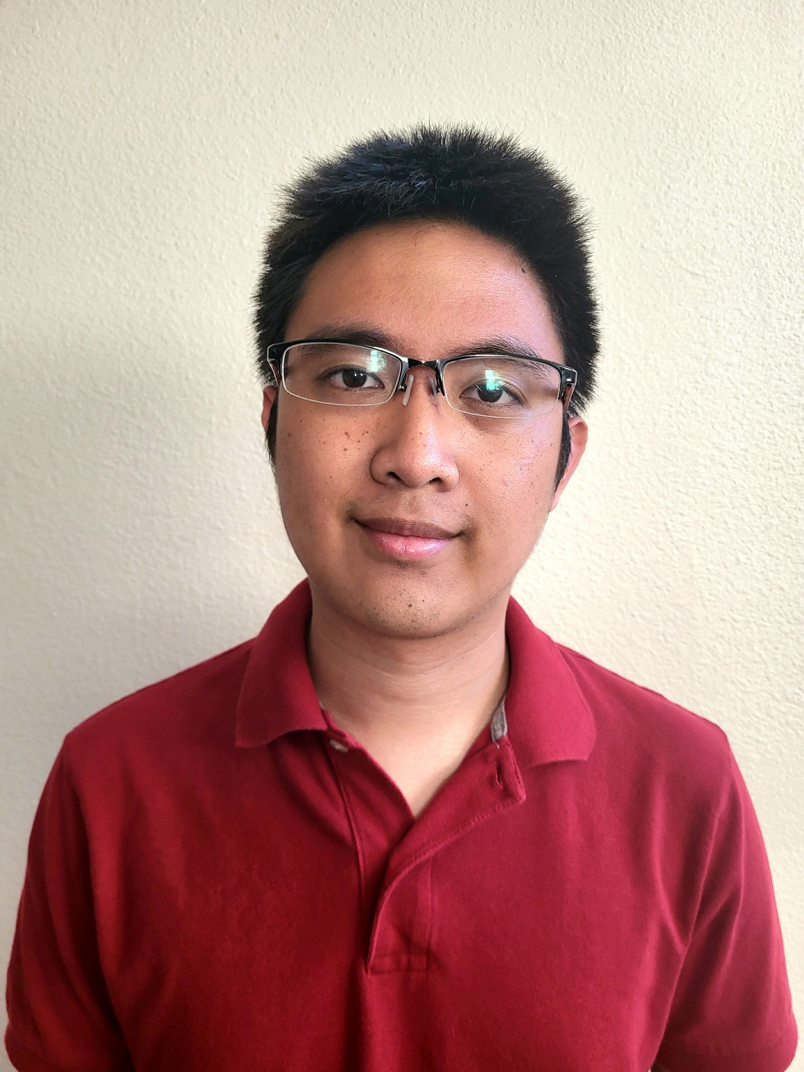

Ryan Millares
Key Selected Experience
Large Non-Profit Company – Full Stack Developer
Relevant technologies: ReactJS, NodeJS, C#/ASP.NET, Azure Active Directory, MS SQL Server
Ryan worked as a full stack developer for a large non-profit company on the addition and enhancement of various features on their business-facing portal website. Native ASP.NET and SQL was used to build out the backend API with new methods to support CRUD operations and other required validations. NodeJS was applied with Azure Active Directory B2C to connect the site to registered applications to enforce sitewide authentication with MSAL. ReactJS was used to enhance the frontend with UI features to support the new API endpoints and overall improve user experience. Source control and collaboration was done through Azure DevOps and GitHub.
Avanade – Full Stack Developer
Relevant technologies: ReactJS, NodeJS, C#/.NET, Azure DevOps, MS SQL Server
Ryan worked as a full stack developer for Avanade on an internal web application that calculated and compared the costs of migrating operations to an Azure Infrastructure-as-a-Service (IaaS) or Platform-as-a-Service (PaaS) based on customizable fields for virtual machines, databases, AppService, and APIs. Primary responsibilities included leveraging ReactJS to implement new features and enhance the UI, implementing new backend API endpoints in C#/.NET to add CRUD features to the app, integrating the API endpoints into the frontend, and managing project sprints and backlog items on Azure DevOps.
Large Auto Insurance Company – Full Stack Developer
Relevant technologies: Angular, Typescript, HTML5, C#/.NET, Azure DevOps, GitHub
Ryan worked as a full stack developer for a large auto insurance company seeking to modernize their quote creation process with Azure-supported cloud storage for security, mobile-first design for user convenience, and improved navigation and features for enhanced experience. Primary responsibilities included using HTML5 and Typescript within Angular to create frontend forms for crucial application features supported with smart data persistence, an intuitive UI for searching tables with numerous filters/parameters, utilizing backend API calls to connect the front-end forms to a database hosted on SQL Server Management Studio, and performing rigorous testing to implement solutions for edge-cases. Used Azure DevOps and GitHub through Agile practices to coordinate code branches, pushes, and merges with rest of team.
Analyst, Full Stack Developer
Software Engineering
Avanade, Inc.
Los Angeles Song 5418 McConnell Ave
ryan.millares@avanade.com
Mobile: (949) 276-1774
Areas of Expertise
Technical
C# / .NET Programming
Angular, Reactjs
Typescript/Javascript, NodeJS
HTML, CSS
SQL Server/PostgreSQL
Java, C++, Python, R
Azure DevOps, Active Directory
Professional Background
Ryan Millares is a software engineer at Avanade with experience in designing and implementing software solutions across various industries. He has hands-on experience working with front-end and back-end technologies in the development of software and web applications. He has strong understanding of Agile Project Management through Azure DevOps and is experienced with collaborating with team members to see a project through its lifecycle.
Certifications
Azure Fundamentals (AZ-900)

